Slide 1
Messi in ronaldo

Slide 2
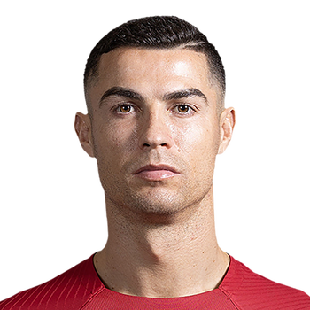

Slide 3
